Slide 1

Application website for e – canara bank

Slide 2
AIM:-
TO ANALYSE E-BANKING FOR CANARA BANK.

Slide 3
REQUIREMENTS
1. LOGIN MODULE
2.USER ID (E –MAIL)
3.PASSWORD
4.WEBSITE(www.Canara.com)

Slide 4
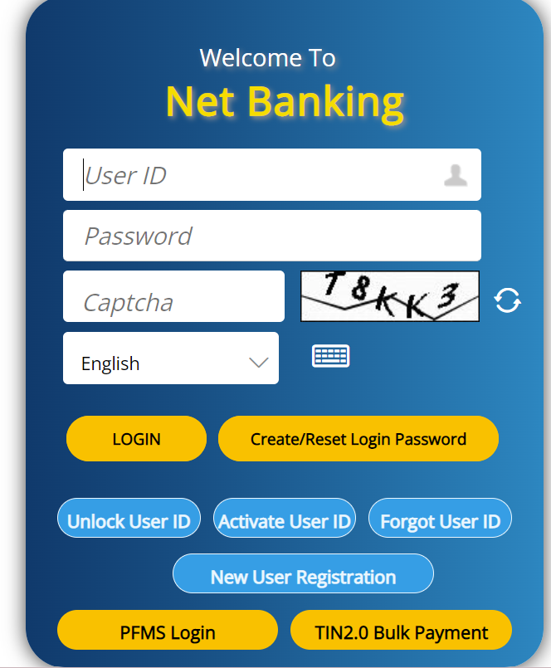

Slide 5
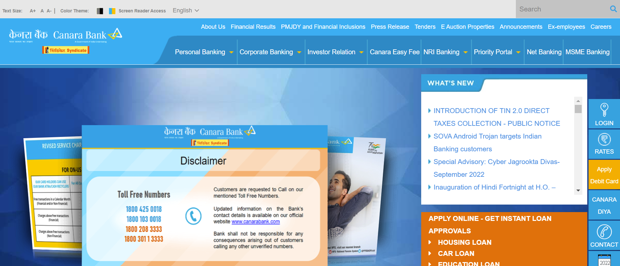

Slide 6
POSITIVE TEST SCENARIO
Enter Valid User ID.
Enter Valid Password.
Click on “Create/Reset Login Password” Link and find out forgot password page.
Click on Create new user Registration account button and verify if it takes to new account page.
Select “Keep me signed in” option to retain login session
Select “Help” option to get help from canara bank.
Select “Privacy Note” to get canara bank privacy polices page.
In Forgot page –Enter the OTP(One Time Password) to recreate the canara bank password.
Clicking on the “Transfer ” .It directly takes to the product page.
Clicking on the “transfer “ link Button. It directly takes to the Otp page.

Slide 7
Negative test scenario :
Enter invalid user id and valid password.
Enter valid user id and invalid password.
Enter invalid user id and password.
Keep one field blank either user id or password and check login.
The price on the image and the on the product was mostly different.
The payment declaim was high in the canara bank pages.
Need to improve the return and replacement options.
Need to improve the UI(USER INTERFACE) on the web site.
When the network was slow the was buffer on that time.
User can transfer the money without internet.

Slide 8
TEST CASES
Test cases | Type – negative/positive
Verify if a user will be able to login with valid user id and valid password. | Positive
Verify the forget password functionality. | Positive
Verify the messages for invalid login. | Positive
Verify if the data in password field is either visible as asterisk bullet signs. | Positive
Verify if user is able to login with a new password only after he\she has changed the password. | Positive

Slide 9
Test cases | Type – negative/positive
Verify if a user cannot login with a valid user id and an invalid password | Negative
Verify the login page for both ,when the field is blank and submit button is clicked. | Negative
Verify the not remember me functionality | Negative
Verify if user able to identify the last password | Negative
Verify if user can login in different systems at a time | Negative

Slide 10
conclusion
I have navigate the Canara Bank web application and find out the positive / pass and negative / fail test cases. This is to improve the application performance in better manner.

Slide 11


